Slide 1
Data analytics project
Salha YAHIA

Slide 2
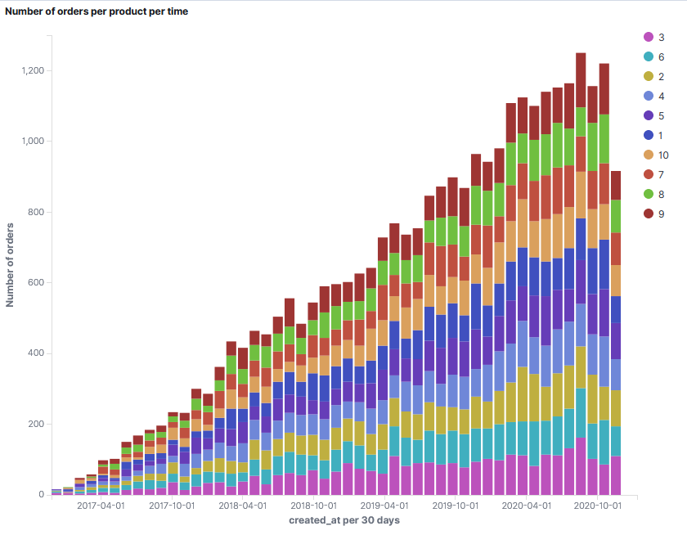
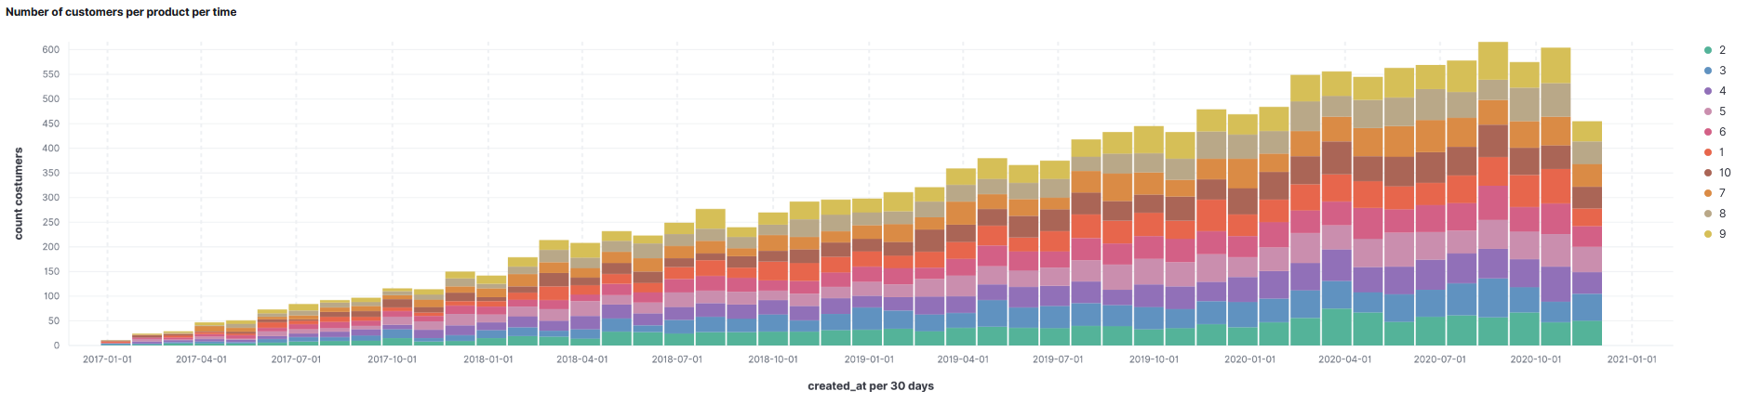
How the company is doing currently
the number of orders is growing from the end of 2016 to 2020 so we have more sales so there is more revenue. on the other hand we notice that there is a fall in November 2020, perhaps because of covid-19, it is a possibility.
Even from this visualization we can know the evolution of each product over time: we notice that the number of orders for each product has increased.
number of customers increases for each product over time. So the income increases, and we have more customers who are interested in other products i.e. customers are satisfied with the products already purchased or the company has become better known so there are new customers
Notes:
1.le nombre des commandes est en croissance de fin 2016 à 2020 donc on a plus des ventes donc il y a plus de revenue.
par contre on remarque qu’il y a chute en novembre 2020 peut-être à cause de covid-19 c’est une possibilité.
même à partir de cette vis on peut savoir l’évolution de chaque produit par rapport au temps: on remarque que le nombre de commandes pour chaque produit a augmenté.
2.nombre de clients augmente pour chaque produit par rapport au temps. donc les revenus augmente, et on a plus de clients qui sont interessés par d'autres produits c'est-à-dire les clients il sont satisfaits par les produits deja achetes ou l'entreprise est devenue plus connue donc il ya de nouveaux clients

Slide 3
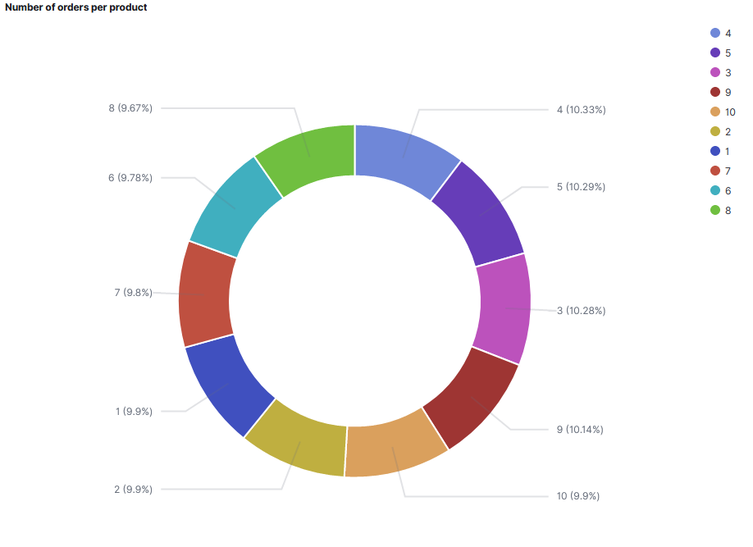
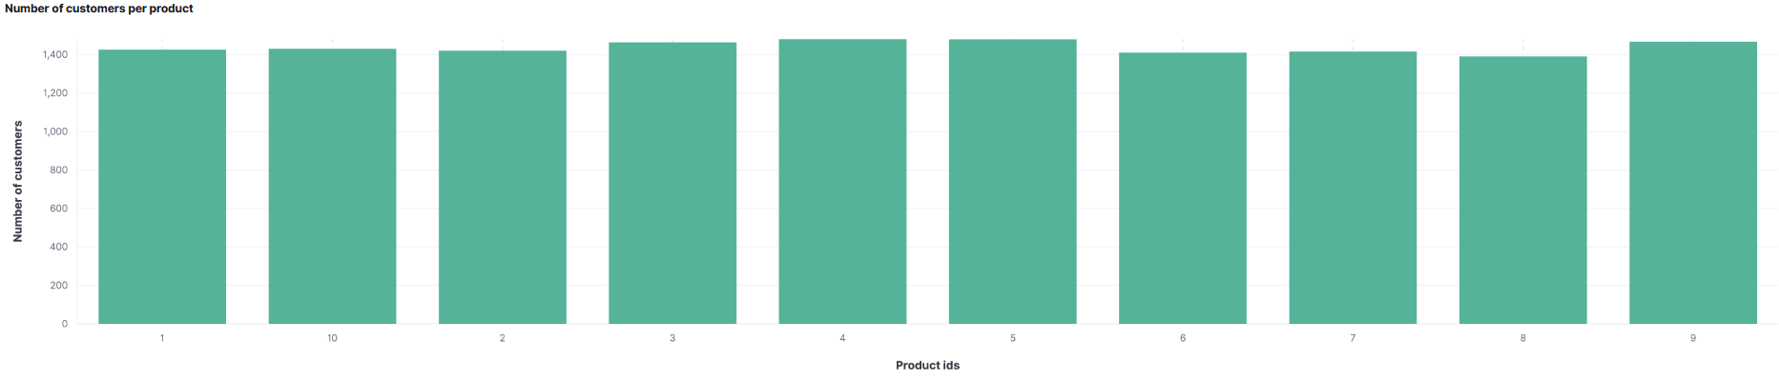
this visualization shows us which product is the most sold: we notice that it is product 4 then 5 and the least sold product is product 8.
each product is bought by how many customers the top product is the most requested by the customers: 4 and 5 so we can make products similar to this products as a recommendation.

Slide 4
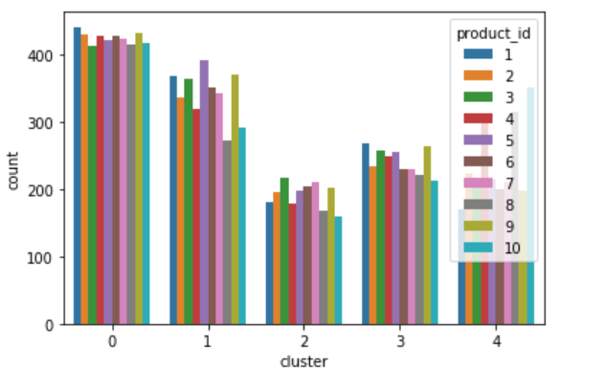
how they can potentially increase revenue in 2021
customer segmentation is done to classify customers into clusters using the RFM (recency, frequency, monetary) method. we have 5 clusters. for example for cluster 1 we can find that customers of this cluster buy more product 5 and 9 and less product 8 so we can: -discount on product 8 to attract more customers to buy it - slightly increase the price of product 8 and 9 or decrease the percentage of discounts on these products and see the results after a few months, if the product continues to be purchased we can increase the price more. - for each client of this cluster we can offer him products that are very popular and he does not buy.

Slide 5
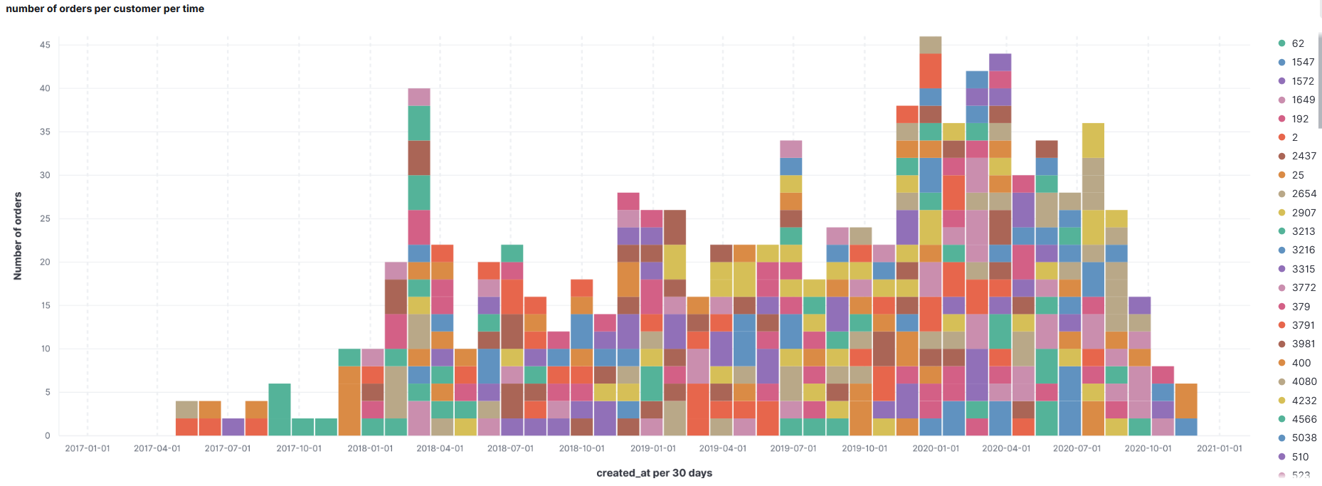
This visualization shows us :
The recency: the last time each customer bought from the company.
The frequency: how many times the customer has purchased. we can know who is the loyal customer and in which month he usually buys, for example he buys in summer so I can offer him products just in summer and send emails just in summer

Slide 6
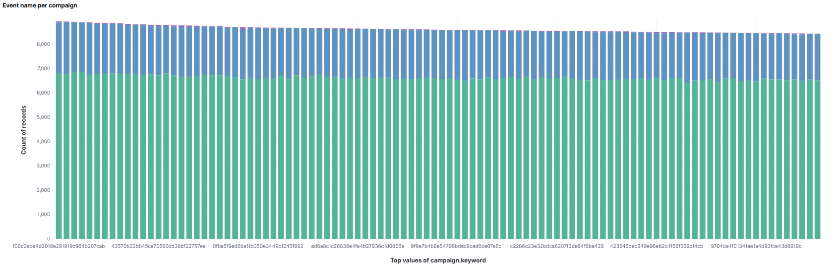
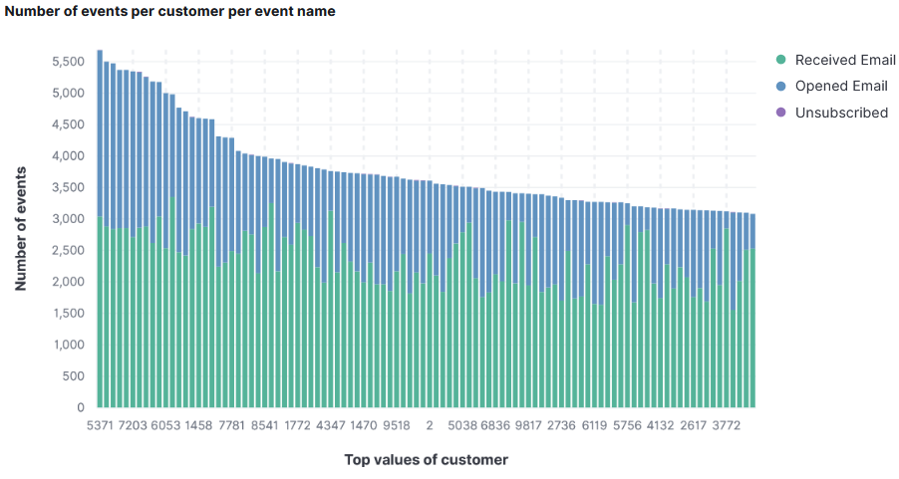
this visualization shows the number of emails received, opened and unsubscribed for each compaign, we can know which compaign is interesting i.e. where the number of opened emails is less close to that received and which non interesting compaign n this case it is necessary change the content of this campaign or you just have to target the customers who will be interested in this campaign.
The top customers open almost all their emails i.e. emails are important to push them to buy.

Slide 7
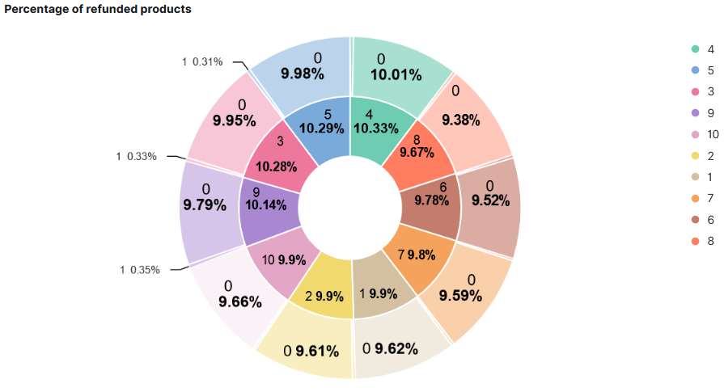
best time for email push: send emails just in the period when the customer is buying from the business.
predict the churn to avoid the de-registration so income increases
We can notice that product 9 has the most refunds. so we must review this product to see what is the problem, we can even call the customer to find out why he made the refund

